Slide 1
Team Riker
Project “Number One”

Slide 2


Slide 3
Under 7 Minutes

Slide 4
Over 50 Slides

Slide 5


Slide 6
Choosing a Topic
We looked for datasets on our original topic, “accidents in surgeries” but could not find enough datasets.

Slide 7
Mental Health in Tech

Slide 8
Choosing a Topic
So we ended up spending all our time on data cleanup from a long running annual survey with no consistent schema

Slide 9


Slide 10
Mental Health in Tech
The Data

Slide 11


Slide 12
Sorry, Wrong Data

Slide 13
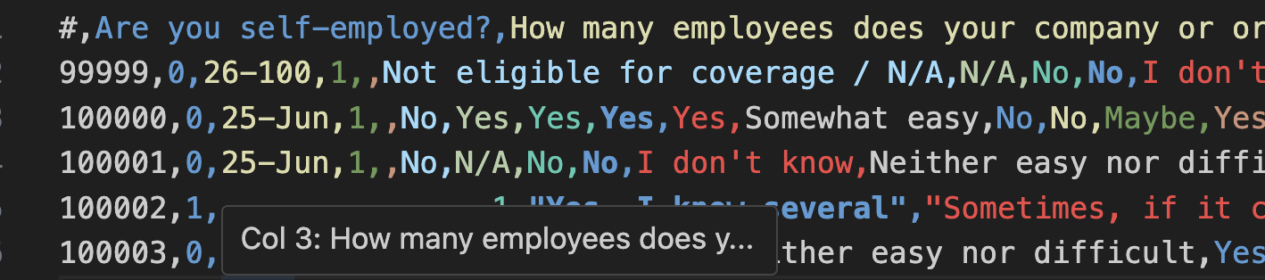
Some data is plain text

Slide 14
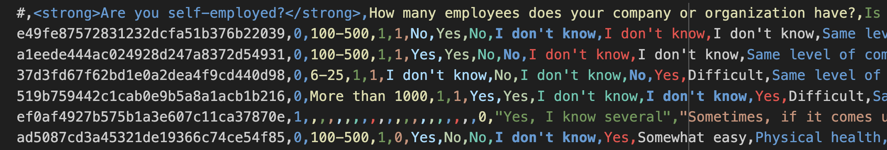
Some data has Html

Slide 15
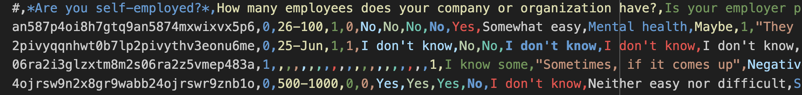
Some has markdown

Slide 16


Slide 17
The Data is Suboptimal
We put ourselves in a significant bind due the the extremely messy nature of our data. However, we intended, regardless of grade to do our best and learn more in the process.

Slide 18
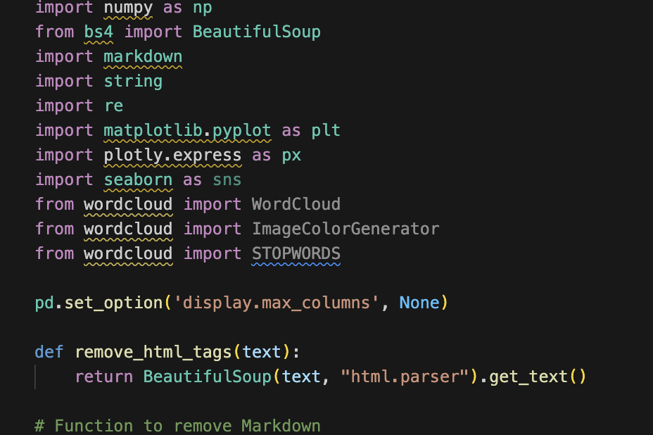
So we began our journery

Slide 19
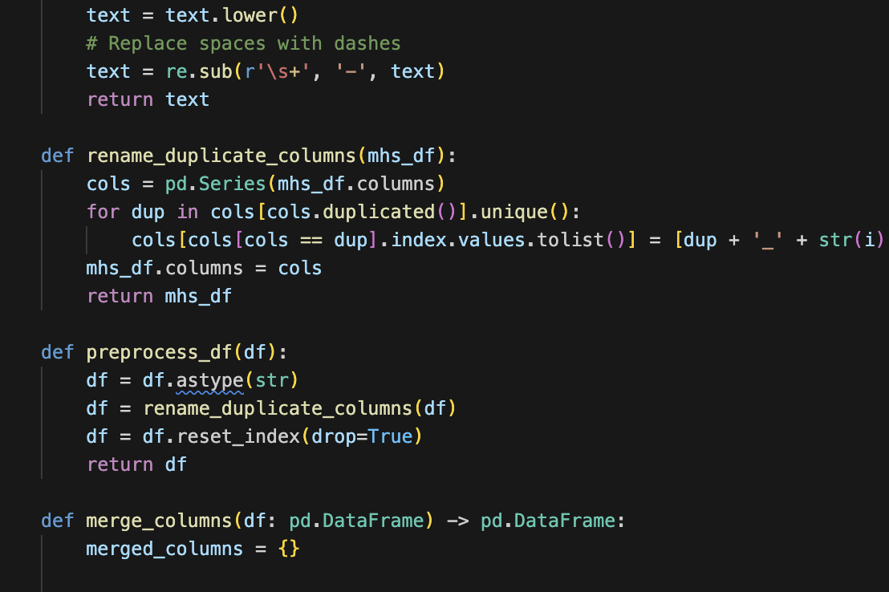
Wrote some functions

Slide 20

Wrote a Column name mapping Dictionary

Slide 21
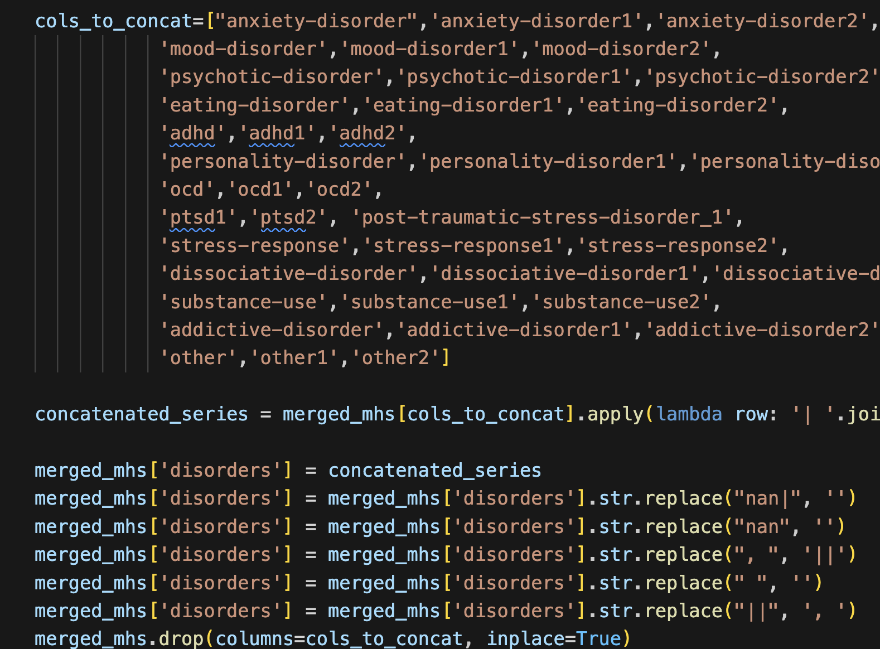
Concatenate Qualitative columns for cleaning

Slide 22
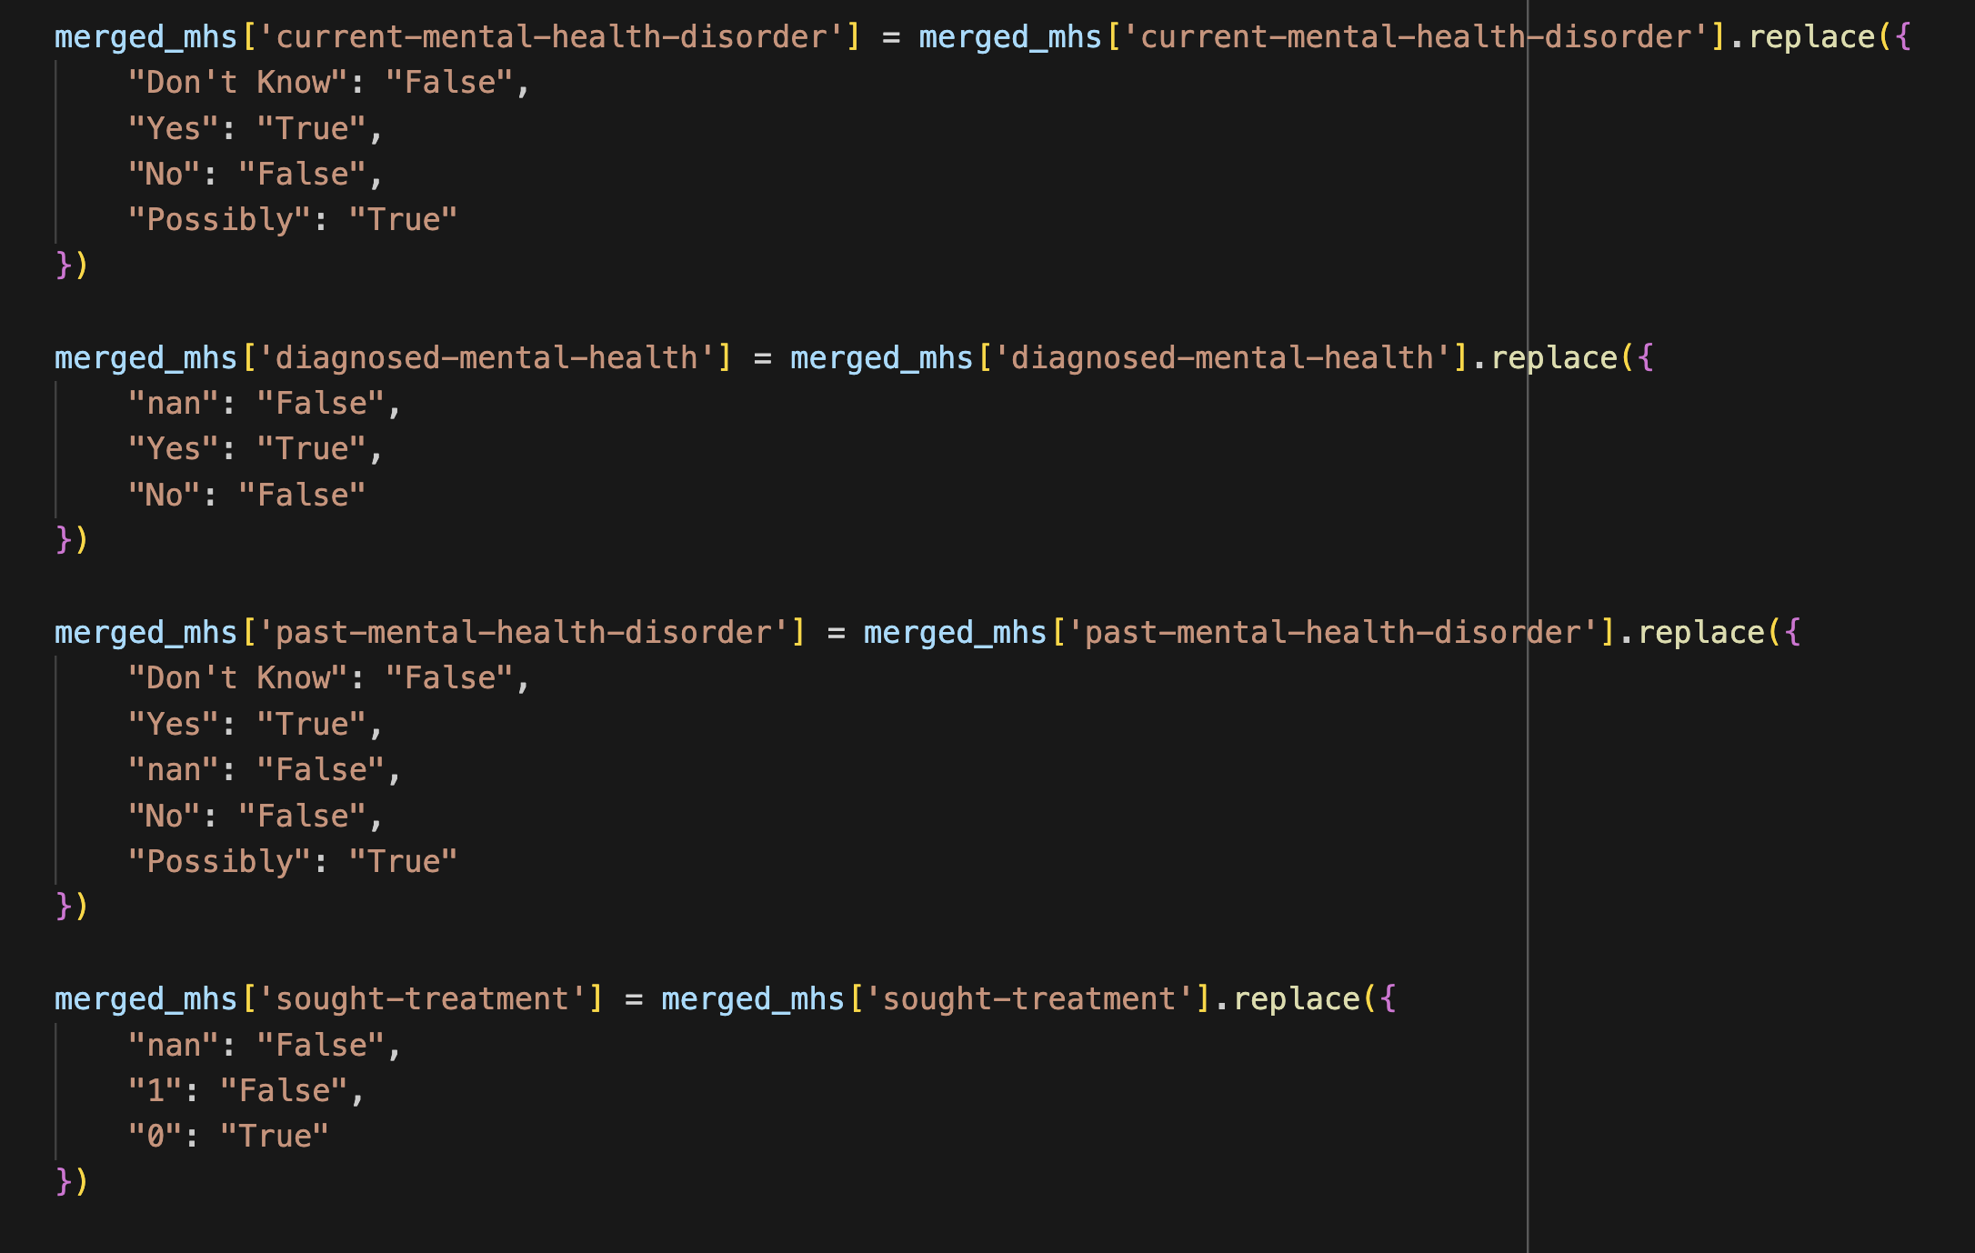
Made the values consistent on 125 cols

Slide 23
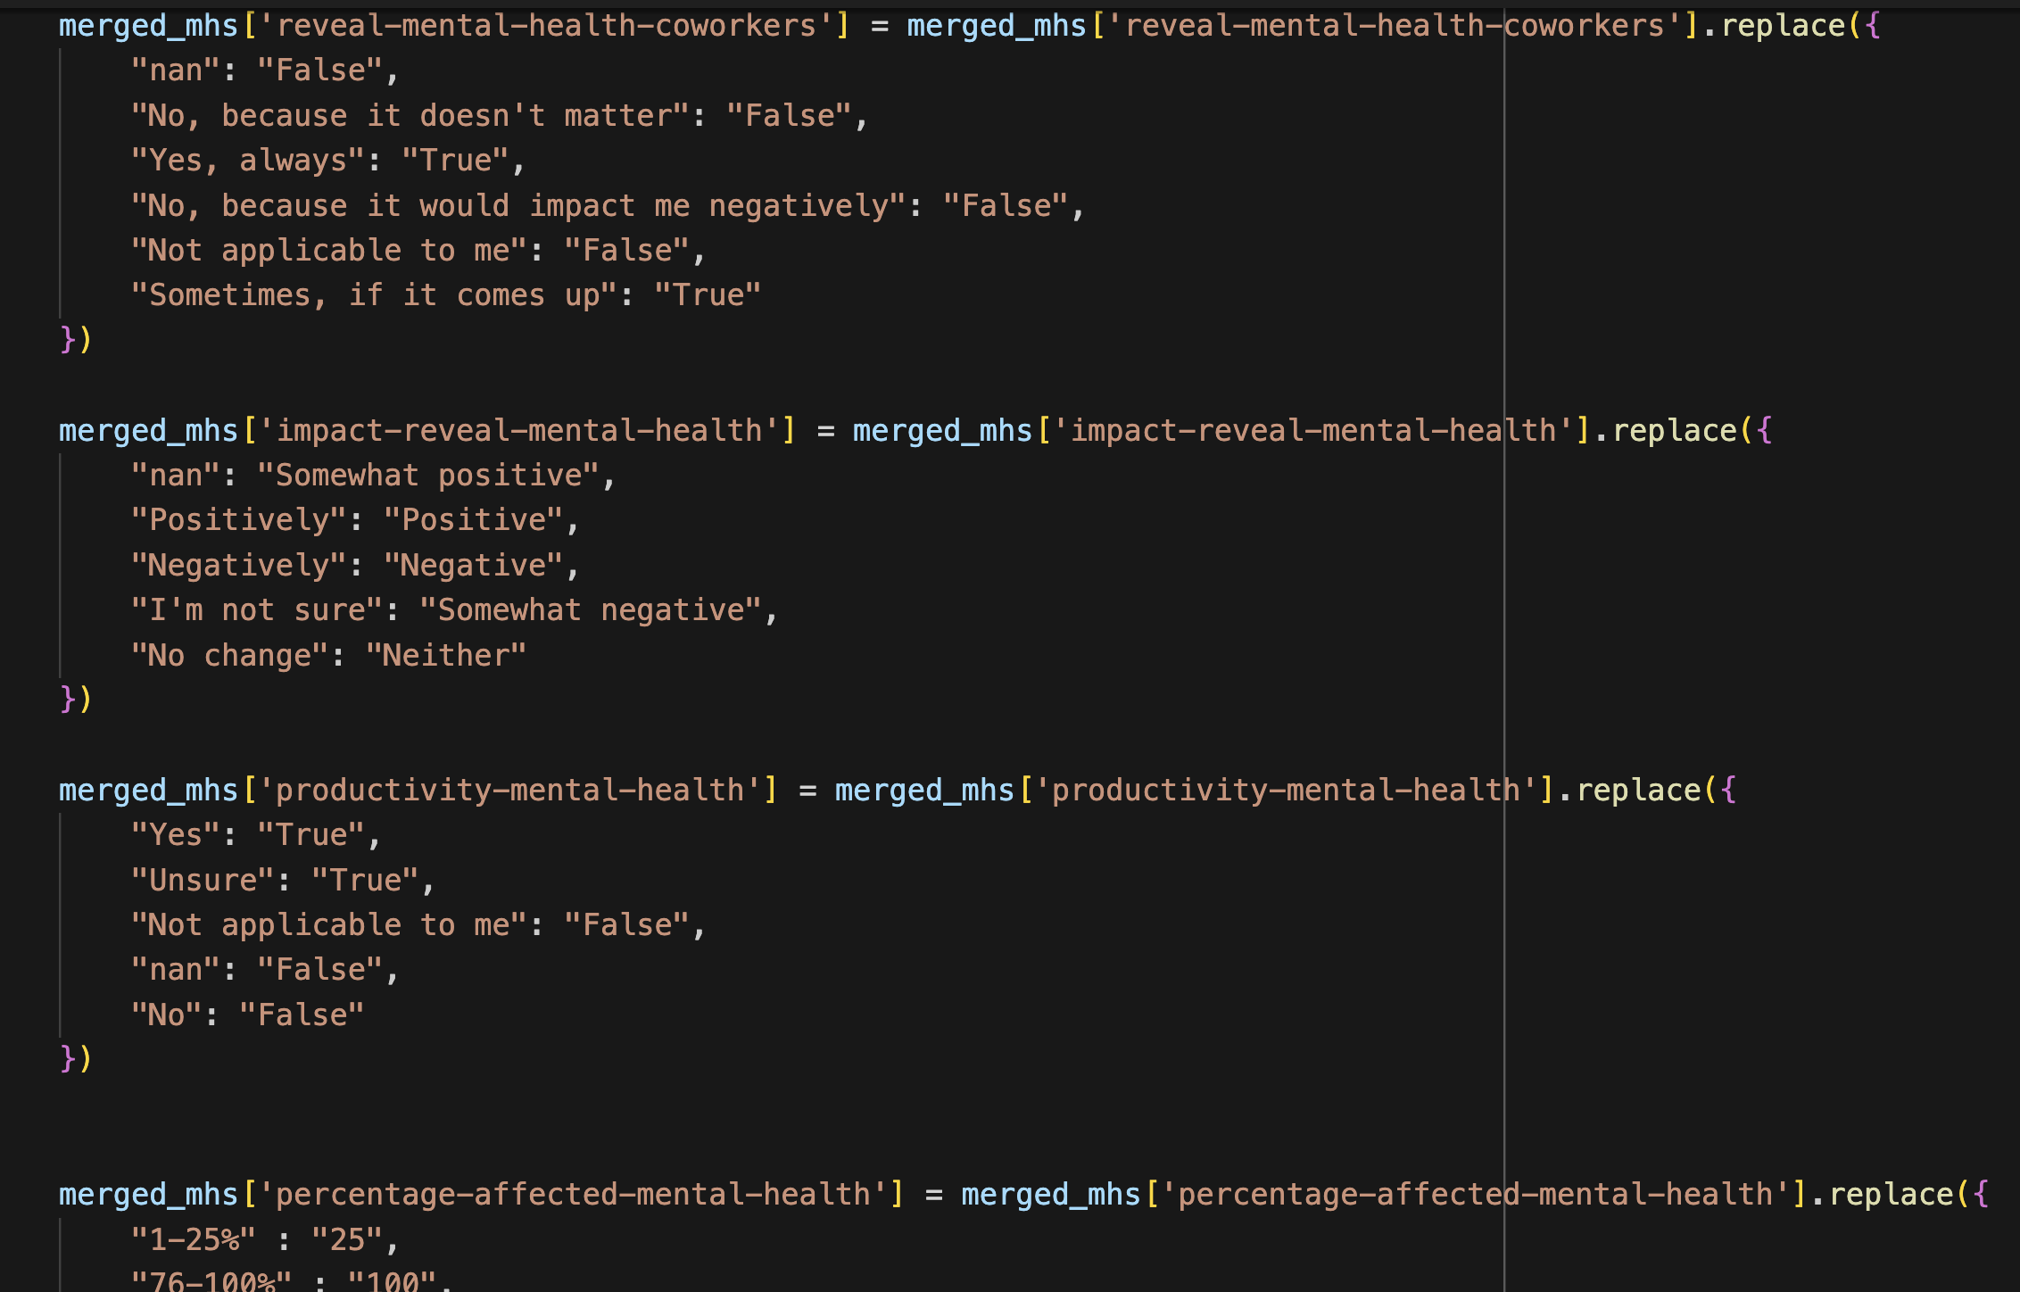
Made the values consistent on 125 cols

Slide 24
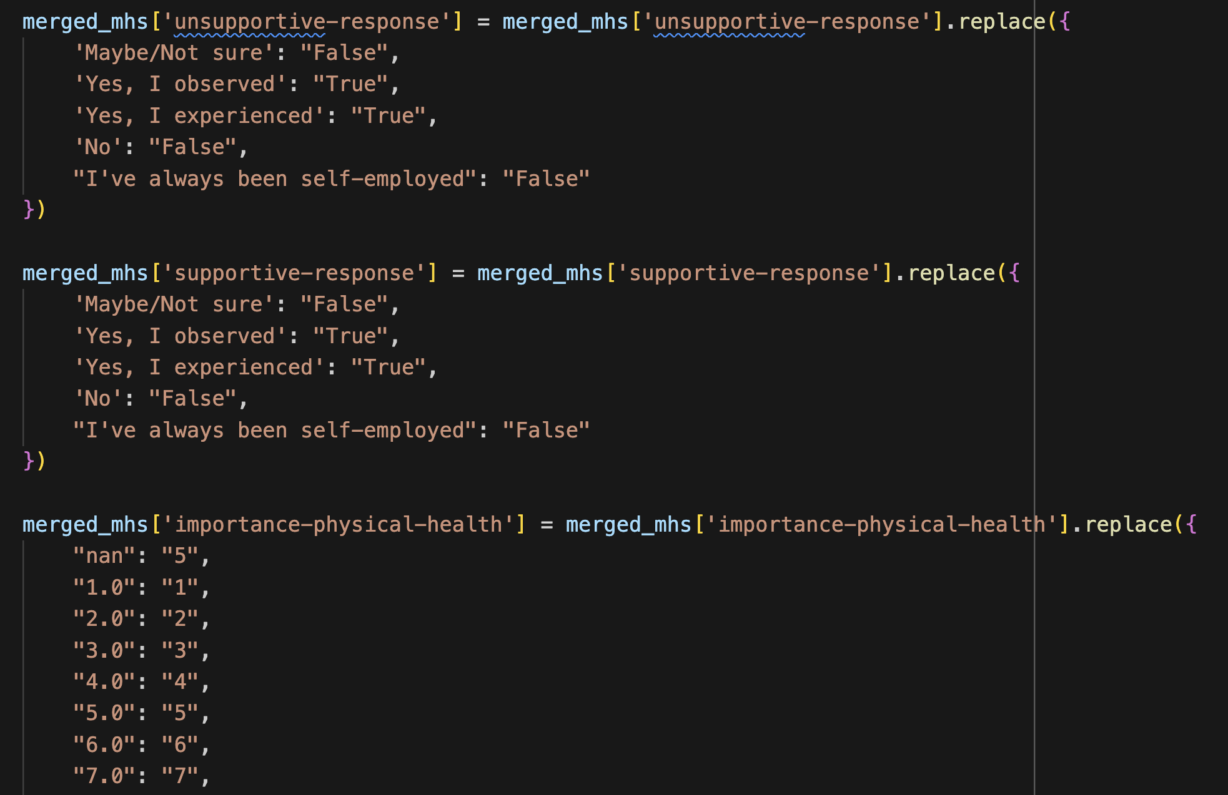
Made the values consistent on 125 cols

Slide 25
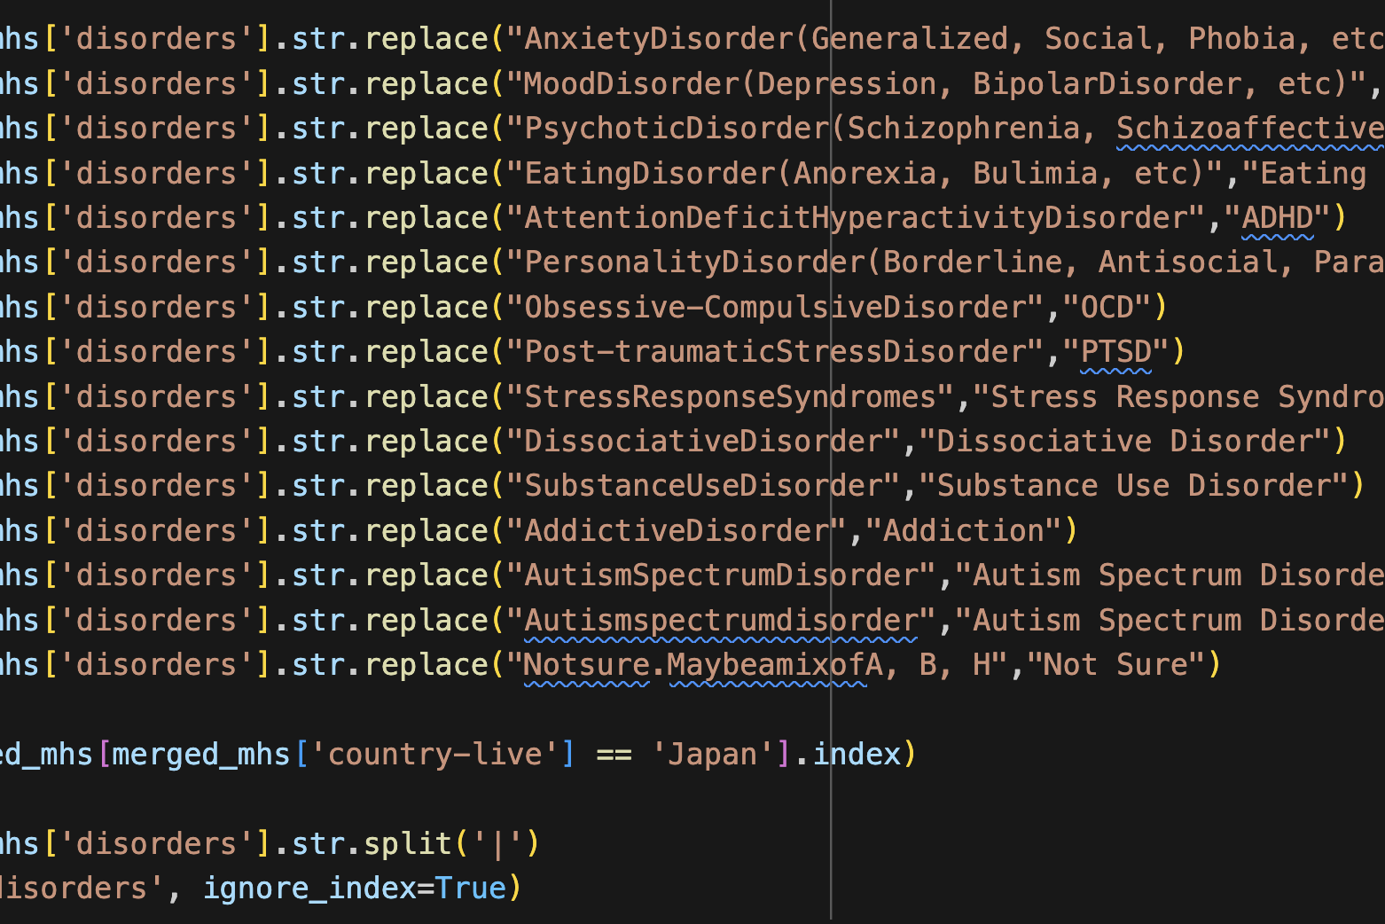
Cleaned the Disorders for consistency and sanity

Slide 26
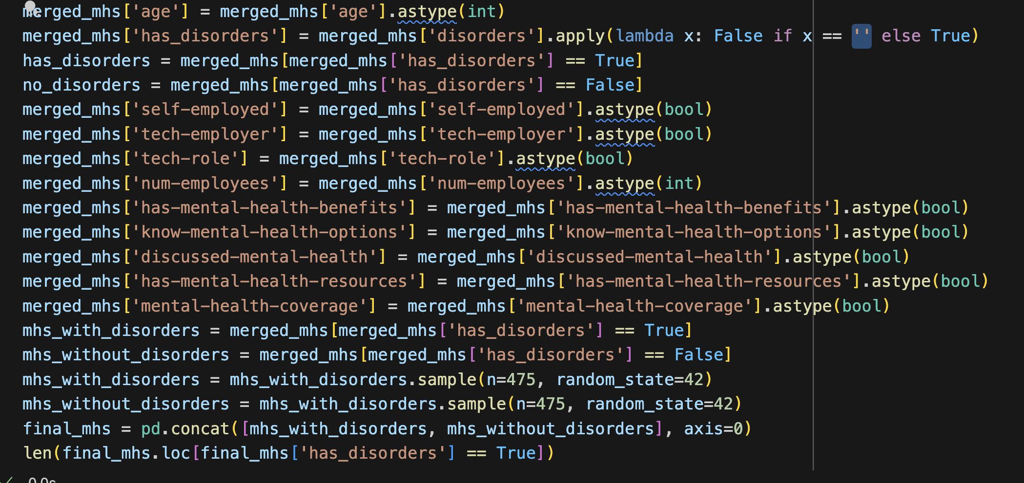
Then fixed some types for fields we needed

Slide 27
Data Thoughts & Recommendations
If you want to write a survey start with an understanding of how you are going to use the data and what is important
Build a general schema that allows that information to be usable and allow for more exploratory analysis
Determine what data points are necessary ASAP so you can elide cleaning non required data.

Slide 28
Mental Health in Tech
Question 1

Slide 29
Do people in Tech Companies or with Tech Roles have more MH issues than their counterparts?

Slide 30
How do we get there?
Clean the data
Prepare 3 visualizations that will provide some insight
Split the data into tech company and non tech company
Count entries in each new DF to find out sample size
Sample from both DFs
Merge Sampled DFs back together
Run visualization
Pray to Hanuman

Slide 31
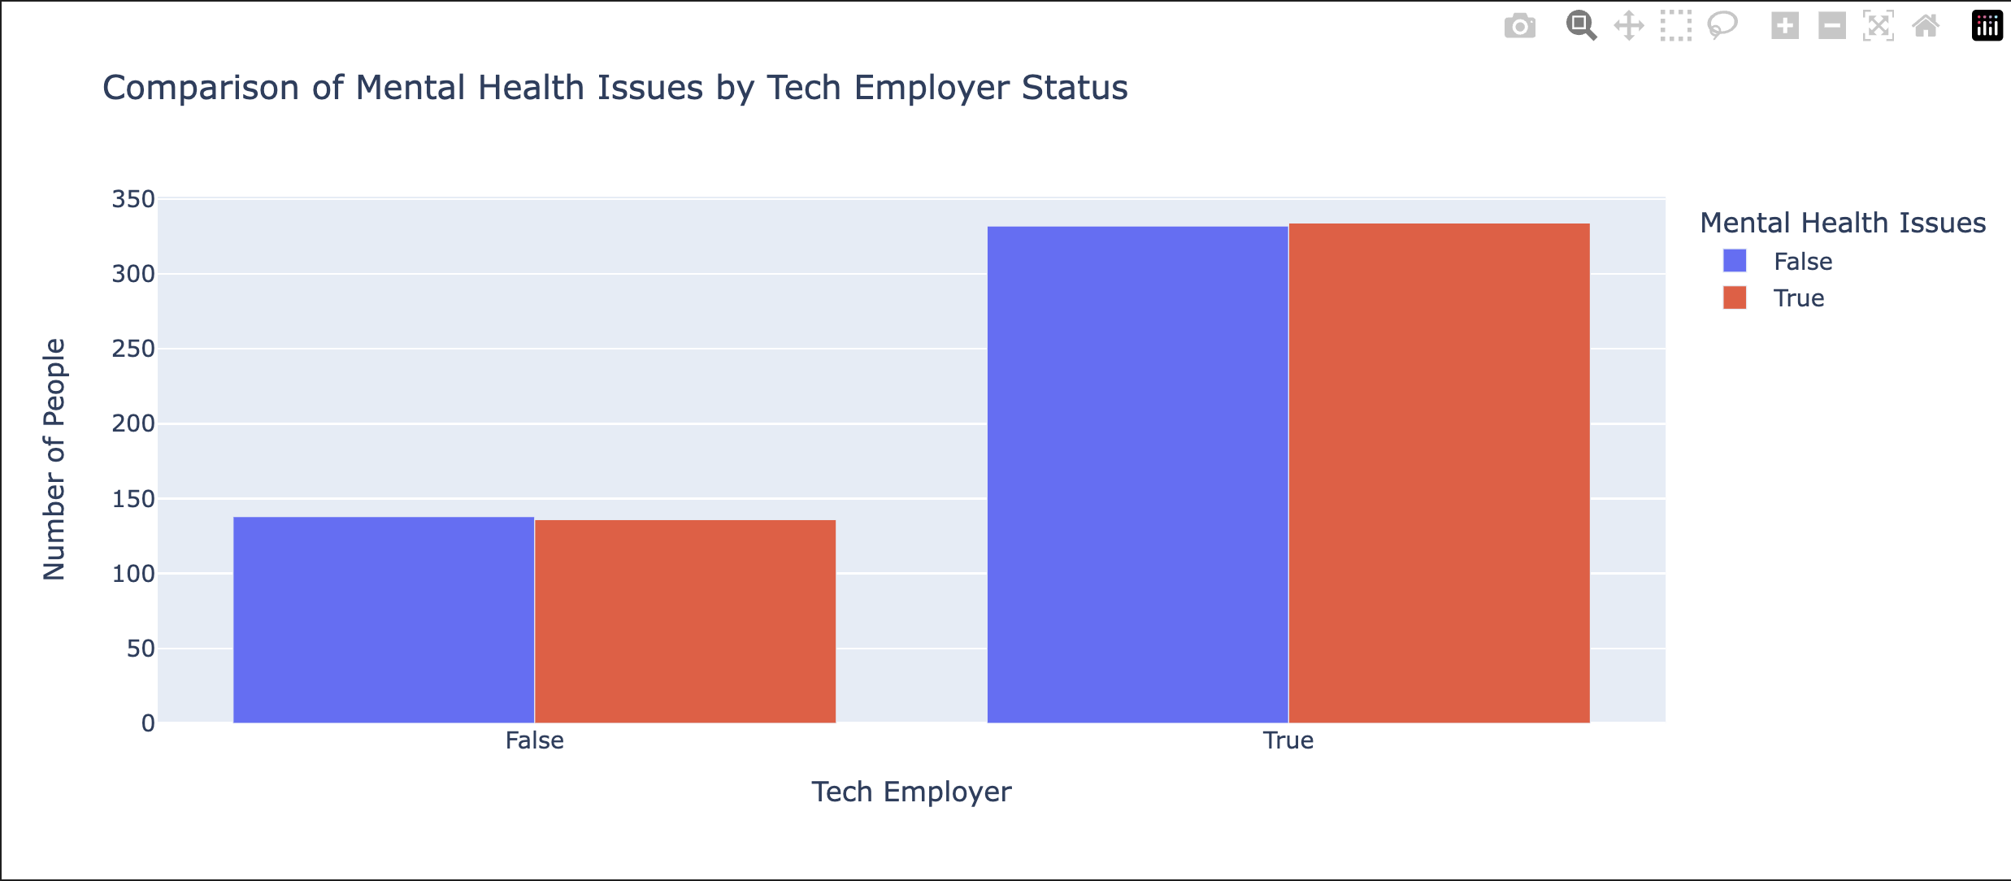
There seems to be very little correlation between MH Issues between Tech vs Non Tech Companies

Slide 32
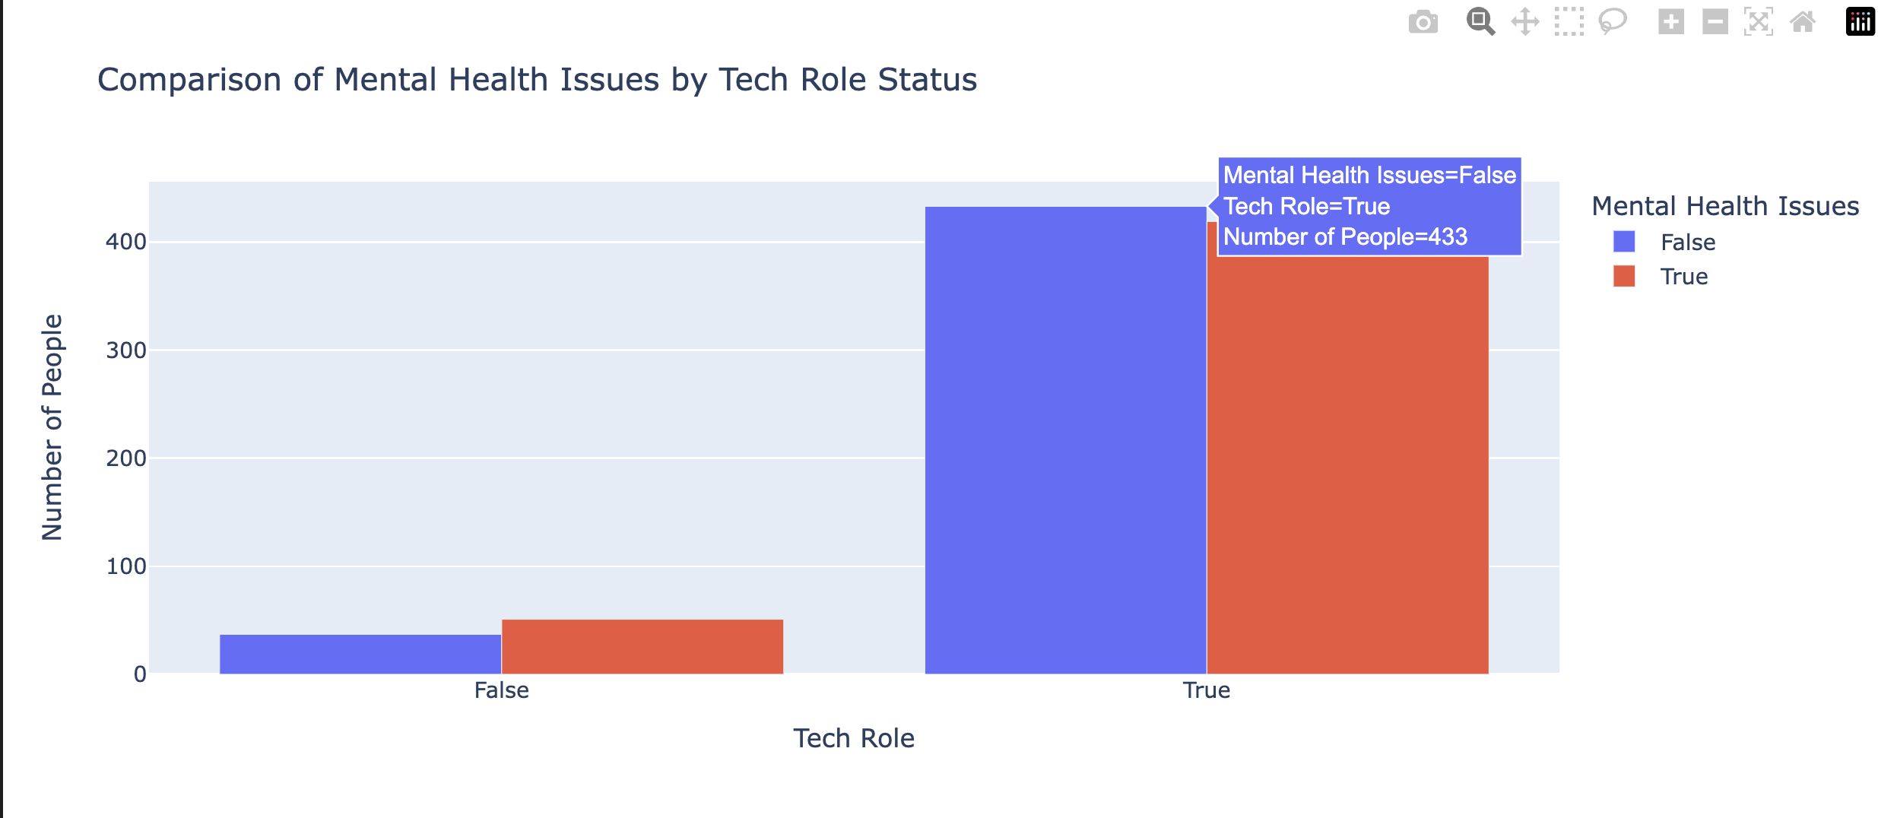
There seems to be very little correlation between MH Issues between Tech vs Non Tech Roles

Slide 33
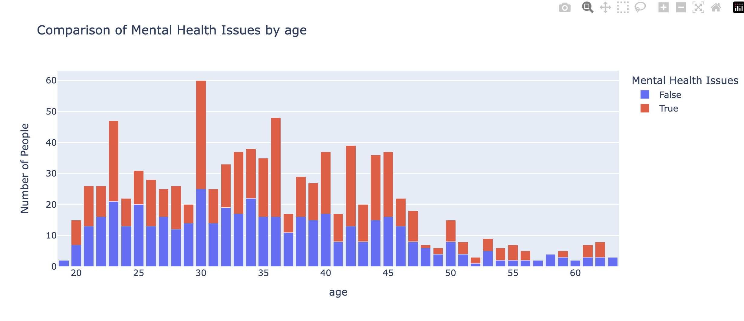
Age does have some correlation to MH issues occurring although perhaps age ranges would be more illustrative.

Slide 34
Analysis & Conclusions
There doesn’t seem to be any correlation between Tech and MH Issues
Is this because of sample size?
Is this because of the burdensome way the survey was structured?
Is Age a factor? Perhaps or it is more about the stress associated with career progression.

Slide 35
Mental Health in Tech
Question 2

Slide 36
Do people in Companies with Wellness Programs have more MH issues then their counterparts?

Slide 40
How do we get there?
Clean the data
Prepare 3 visualizations that will provide some insight
Split the data into tech company and non tech company
Count entries in each new DF to find out sample size
Sample from both DFs
Merge Sampled DFs back together
Run visualization
Pray to Hanuman

Slide 41
Analysis & Conclusions

Slide 42
Mental Health in Tech
Question 3

Slide 43
Do USA Tech Employees have more MH issues than International Tech Employees?

Slide 44
How do we get there?
Clean the data
Prepare 3 visualizations that will provide some insight
Split the data into USA and International locations
Count entries in each new DF to find out sample size
Sample from both DFs
Merge Sampled DFs back together
Run visualization
Weep

Slide 45
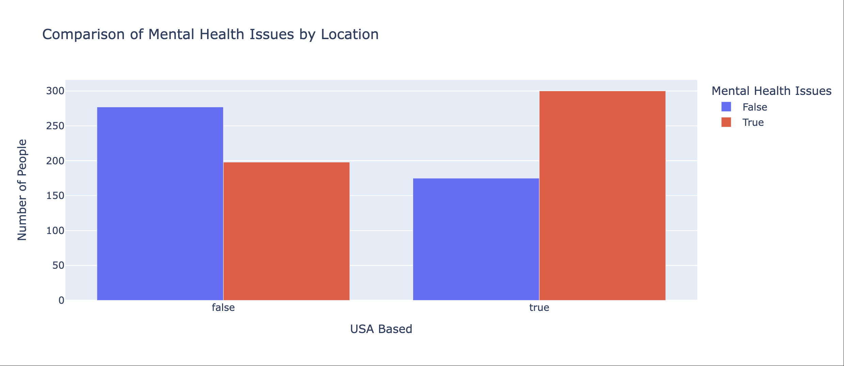

Slide 46
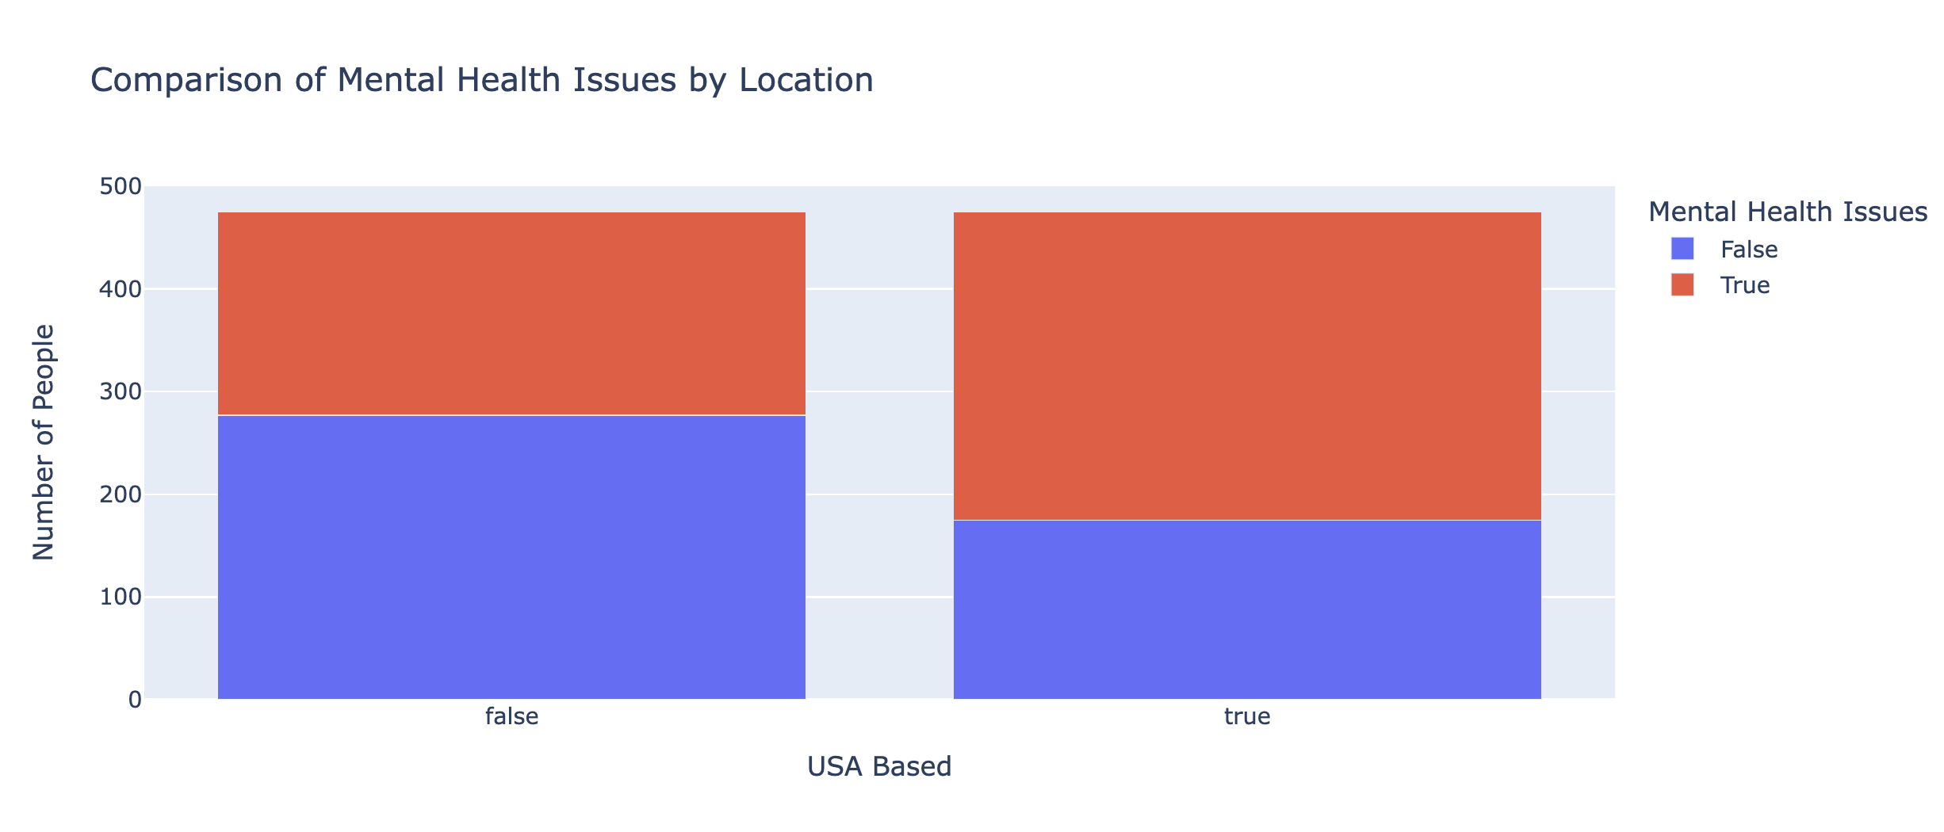

Slide 47
Analysis & Conclusions
The USA has more tech Mental Health issues
Is this because of overall work culture?
Is this because of wellness programs that are built into national health systems
Is it because there is less of a culture of coming forward with MH issues

Slide 48

Not Enough Data

Slide 49
Also, DS9 is much better than TNG

Slide 50


Slide 51
Thank you for coming to our Ted Talk
Dhruba, Ravi and Brendan

Slide 52


